Slide 1



Capital Health Network
Emergency Preparedness
Stacy Leavens
CEO, Capital Health Network
2 April 2026

Slide 2


Objectives
The presentation objectives are to:
Improve the understanding of CHN’s role and capabilities in supporting emergency preparedness, response and recovery
Identify future capabilities, next steps and opportunities to align with ACT Health plans and priorities

Slide 3
Role of PHNs in emergency preparedness and response
The primary objectives of Primary Health Networks (PHN) in health emergency planning and preparedness, as per PHN Core Funding agreements, include:
Coordinate
Build Capacity
Continuity of Access
Support and coordinate the primary care contribution to health emergency preparedness and coordination processes to identify primary health needs and build preparedness and resilience.
Make plans to support local primary care providers continuing to operate during emergencies e.g. by arranging alternative premises
Assist local primary care providers in emergency planning, response and recovery.

Slide 4
Role of PHNs in emergency preparedness and response
PHNs are expected to undertake activities in collaboration with and guided by State/Territory emergency plans.
Activities may include, for example:
Emergency preparedness communications
Plan for infectious disease scenarios and scenario training with the sector
Plan for climate-related disaster scenarios and scenario training with the sector
Identify workforce capacity, such as surge workforce
Standing up additional services in an emergency
Monitoring service capacity during an emergency
Monitoring preparedness such as practice readiness audits
Education and training

Slide 5
Capital Health Network’s Role
CHN recently engaged with our 3 Advisory Councils – Clinical Council, General Practice Advisory Council, and Community Council - to identify priorities for CHN with regard to emergency preparedness and response.
Key activities for CHN in emergency planning identified include:
  Communications to primary care health sector
  Supporting the primary care sector and broader health sector in identifying people and strategies for proactively engaging e.g. significant heat wave - working with practices to identify at risk patients using data systems and recall.
  Monitoring and understanding capacity of primary care services and workforce during an emergency
  Supporting business continuity planning and response across primary care
  Collecting information from primary care stakeholders and feed back to ACT HCSD and Commonwealth Government.
Councils emphasised importance of coordinated activity that complements and supports ACT Government-led responses.

Slide 6


Current capacity and capability:
Primary Care Engagement and Communication
CHN’s Quality Improvement Team can:
Support communications to health professionals to disseminate public health and clinical updates
Coordinate communication and engagement with general practice, pharmacy, residential aged care homes and allied health
Coordinate education, webinars and events with primary health professionals and stakeholders
Coordinate and support vaccination programs, PPE delivery, workforce support
Coordinate and deliver post-event supports such as mental health support for health professionals and business continuity support

Slide 7



Current capacity and capability: HealthPathways
Leveraging the HealthPathways platform, CHN is able to provide
up-to-date clinical guidance and information on referral pathways before, during and after emergencies. HealthPathways can:​
  Be responsive to local needs including localised referral pathways while drawing upon national subject matter expertise​
  Help to ensure that GPs and allied health professionals have access to current, evidence-based care instructions for disaster and related clinical conditions
  Disseminate clinical updates and alerts​
  Support cross-border response arrangements with SENSW, as HealthPathways is a joint program with Coordinare (SENSW PHN).
For more information: www.chnact.org.au/for-health-professionals/healthpathways​​

Slide 8

Current capacity and capability: Commissioning
CHN can support emergency response through commissioning such as:
  Ability to engage with our commissioned service providers to surge/increase capacity in response to emergencies
  Grants and commissioning processes that can be activated for emergency-specific funding
  Monitoring capacity and demand on NGO health sector during emergencies.

Slide 9


Current capacity and capability:
Primary Care Emergency Response Committee
The ACT Primary Care Emergency Response Committee (ACT PCERC) was formed in 2019 in the context of ACT/SENSW bushfire emergency and continued to meet during the COVID-19 pandemic. CHN provides secretariat and coordination support to the ACT PCERC.
ACT PCERC purpose
  Be involved in prevention, preparedness, response and recovery to emergencies and disasters.
  Facilitate communication between the primary care sector, public health and clinical emergency response efforts.
  Promote the effective utilisation of primary care clinicians in local emergency responses.
More information: www.chnact.org.au/for-health-professionals/primary-care-support-2/health-emergencies

Slide 10
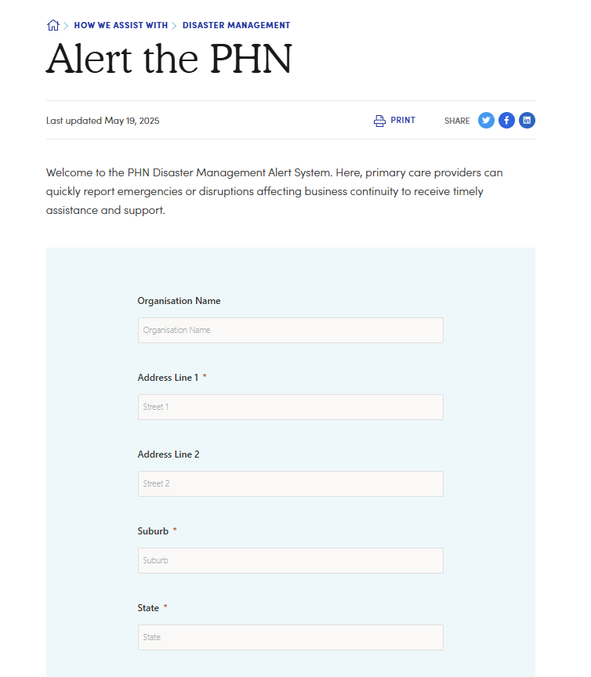


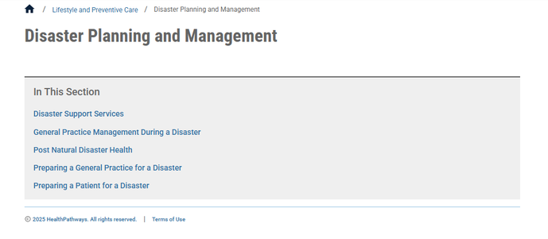
Leveraging the PHN Network
CHN is part of a broader network of PHNs that we draw upon to plan and share learnings:
Sharing resources
Joint HealthPathways Development
Communities of Practice

Slide 11



Next steps and future capabilities
Review and enhance communications channels and systems in context of emergency preparedness and response
Identify systems and processes for monitoring primary care system capacity in an emergency
Align CHN actions and activities with ACT Health Emergency Sub-Plan and HEMC Work Plan
Align PCERC actions and activities with ACT Health Sub-Plan and HEMC Work Plan

Slide 12

Proposed work plan for PCERC-TBC
Proposed approach:
Standing agenda:
Public health update
2. Strategic discussion on key priority topics aligning with HEMC work plan or CHN priorities such as:
Systems and data for monitoring primary care capacity in an emergency
Communication channels
Role of primary care in heat waves,
Seasonal preparedness
Available trainings and resources.
3. Lessons learned/after action events
4. Sector updates
5. Other business/emerging issues
3 meetings per year, with option to stand-up more regularly in an emergency

